Slide 1

2014 Revenue Resources - Proposed Budget

Slide 2
Basis of Accounting
The State of Washington and the State’s Auditor’s Office set the accounting standards that we use here in Yacolt. As such, Yacolt records revenue and expenses on a cash-basis, similar to most small businesses, and is required to have an audit every two years. We prepare a budget every year and by law, we are not allowed to operate in a deficit.
The City uses fund accounting which is a way to separate activities by type. In broad terms the City has three major types of activities– governmental, proprietary and capital projects. Governmental activity, often called the Operating Budget, includes police, streets and park services and is what most people think of when they think of government (at least when they’re being kind). Property taxes are the main source of revenue funding the Operating Budget.

Slide 3
Proprietary activity includes utility services – storm water, cemetery and it is funded through user fees. By law we cannot use your water and sewer fees to support general government and the operating budget.
Capital Projects are the last major type of activity. As the name implies these are construction projects which can be governmental or proprietary in nature depending on the project. These are usually funded by major grants.

Slide 4
Property Tax Revenue
Property taxes are single most valuable resource for the town.
With out property tax revenue Yacolt would cease to exist as a Town.
This revenue type is the only source that is guaranteed to be a steady source of funding.

Slide 5
1/3 of the property tax dollars that are allocated to the town are placed in the General Fund or General Operating Fund
2/3 of the property tax dollars that are allocated to the town are placed in the Street Fund
Each year municipalities, fire districts, are allowed to increase property tax levy by 1% without a vote of the people.

Slide 6
Does the Town keep all collected property tax dollars?
NO
The town only gets to keep a portion of the tax dollars that are collected. The funds collected are distributed to various districts in the county.

Slide 7
*Includes regional districts such as libraries, parks and recreation, emergency medical and hospitals. Not necessarily located in the Town.

Slide 8
Doing a lot with a little
And yet that 14% sliver provides us with 67% of our total operating revenues.
That means we provide the bulk of our services, public safety, parks and streets with a relatively small amount of your money. Here’s a chart showing how your property tax dollar is used.

Slide 9
Where does Property Tax go?
This does not include State Share Revenue which makes up the difference in fund totals, however these revenues vary from year to year depending on legislation.

Slide 10
1% Increase
In 2012/2013 the Council elected to not pass the constitutional limit 1% tax increase. This equated to no increase in property tax to residents and in the process reduced the actual collected dollars of tax revenue needed to support services.
This created what is known as banked capacity.

Slide 11
Banked Capacity
The Landscape of Levy Limits
Most levies in Clark County are subject to several levy limits. Some of these limits are on growth of the total levy dollar amount, while others limit part of the formula used to calculate the [total levy dollar amount], such as limits on the levy rate.
The Great Recession and Levy Limits
The Great Recession impacted home values throughout Clark County, causing them to fall substantially. Home values are part of the formula that is used to calculate the [total levy dollar amount] for districts. When home values dropped, that changed the equation and many districts hit their limit on their levy rate. The limit on the levy rate worked as intended – districts cut their [total levy dollar amounts] as home values fell and the recession wore on.

Slide 12
The Recovery
Now that the recovery has begun, home values in Clark County are rising fast. The formula for calculating the [total levy dollar amount] for districts is changing and they are no longer hitting their rate limits. However, there are still limits on the growth of the [total levy dollar amounts]. These growth limits are not intended to limit districts in their ability to return to pre-recession levy levels. That’s where banked capacity comes in – it allows districts to recover from the recession as fast as home prices recover. Banked capacity is mathematically designed to “dry up” once the county, home prices, and districts have completed their recovery, allowing the limits on the growth of the [total levy dollar amounts] to kick back in.

Slide 13
Using Banked Capacity
To use banked capacity, districts have to pass an ordinance or resolution asking for an increase over the total dollar amount they levied in the prior year. Most people are used to seeing the typical increase capped at 1%. Banked capacity allows districts to ask for more than just a 1% increase – this process gives the public the opportunity to weigh in on the speed of the district’s recovery using banked capacity.

Slide 14
How much Banked Capacity to Use
Even if a district uses banked capacity, they are still capped by their statutory rate limit. This keeps the recovery of districts in line with the recovery of assessed values within them. Banked capacity is also re-calculated each year from the difference between the Highest Lawful Levy limit and the actual amount levied. This means that banked capacity cannot be overused – other limits will kick in and the capacity is recalculated next year based off the amount the district actually managed to levy.

Slide 15
How much money was collected from residents in Town?
In 2012/2013 the amount collected from property tax to support services was certified by the County Assessor at a value of $133,444.38. That equates to $2.0473190881 per 1000 in assessed value.
As suggested in the previous slides the amount collected was less in view of the lesser home values.

Slide 16
RECAP
Most levies in Clark County are subject to several limits, some are on the growth of the levy, while others are on how the levy is calculated.
During the recession, many districts hit their levy rate limit; this made their levies drop in step with the drop in home and other values within them.
Now that the recovery has started, home values are rising quickly. To allow the districts to recover at the dame pace, they can now use what’s called banked capacity to ask for growth in their levy that is higher than the normal 1% limit.
The capacity to ask for faster growth is still limited by the rate limit, which means districts cannot recover faster than the home or other property values within them.
A district can use their banked capacity each year until the values within them recover and their limit on levy growth kicks back in.
All other things being the same, by using banked capacity to its fullest potential, taxpayers will see their total levy bill from our district rise back to pre-recession levels roughly at the same pace the value of their home or other property recovers.

Slide 17
What are State Share Revenues
These are tax dollars collected that are shared among the county, cities and towns based on per capita and % that are determined by the State Legislative Authority.
Examples of Share Revenue are:
Motor Vehicle Tax
Liquor Tax
Liquor Excise Tax
City Assistance

Slide 18
Liquor Board Profits
Criminal Justice
However these revenues are governed by the State in how they are allocated to funds and how they are allowed to be spent.

Slide 19
Liquor Taxes
In the past cities/towns collected these funds which assisted in the ability to balance budgets, but with the passage of Initiative 1183 that all changed. The State passed 3 pieces of legislation in the past 2 years which is having an impact on the revenue received by cities.

Slide 20
With the privatization of liquor, the mark ups that were on liquor were replaced as a state revenue source by license fees that are paid to the state by retailers and distributors. This impact was felt directly in the liquor profits.
2012 legislation was passed that diverted all the city and county liquor excise tax revenue to the State general fund for FY 2013. It also provided a for a permanent diversion of $2.5

Slide 21
million per quarter( $10 million per year)of city and county money from the liquor excise tax fund to the state general fund, effective 2014.
Since 80% of liquor excise tax is distributed to cities and 20% to counties, $2 million of this quarterly transfer comes out of city money and .5 million from the county money.
2013-2015 State budget, passed by legislators contains a provision that increases their take of the money even more from 65% to 85% leaving cities and counties only a 17.5% share which is a 50% reduction in share revenue.

Slide 22
These 2 pieces of legislation are in conflict with each other. The jury is still out on how this will all work.
AWC ( Association of WA. Cities) is lobbying hard on behalf of all the cities and counties in the State. They are working toward a resolution to resolve the differences and “put back revenue”. When there is a decision we will know.
As a result we will receive less revenue regardless of the outcome.
These funds are distributed to both the
General Operating Fund and Streets and
make up the difference in fund revenue.

Slide 23
What other revenue resources are available?
Additional components of revenue sources are even less of a guarantee:
Charges for Services
Licenses and Permits
Fines and Forfeitures'
Charges for Services funds come from things like faxes, notary, rentals, copies etc.

Slide 24


Licenses and Permits funds come from business licenses and building permits. While minor construction is on going in the Town, housing and major construction has come to a stop. This has a large impact on Streets and Parks since most of the funds collected benefit those areas.
Business Licenses have been somewhat consistent revenue over the last couple of years. The challenge is keeping business’ here and doing business. Other side is catching those who are doing business in the Town with out a license/permit.

Slide 25

Fines and Forfeitures funds come from the Criminal Justice funds that are allocated to the Town. These come from criminals who are fined and must pay restitution. Again based on per capita. We only receive 68% of total fine/restitution and the remaining 32% goes to the state. In addition 1.75% of the local portion must be remitted to the county for crime victims and witness programs. (NOTE: all money received from DUI are remitted to the state not locally).
Some of the funds also come from local
fines such as animals at large, no pet license
but we have to catch them and then find
the owners and hope they pay. IF not it is
a charge to the town to have animal control
pick up the animals and only if the owners
retrieve their pet do we collect funds.
We have limited animal control services.

Slide 26
Storm Water Fees
Yacolt residents pay storm water fees that are realized on their monthly Clark Public Utility Bills. While this is a source of revenue it has restrictions as indicated above in Basic Accounting. This is a separate fund that has limitations on expenses that can be charged to it. Examples: drainage, soil and water conservation, engineering plans and studies. These are NOT funds that can be used in General Operations

Slide 27
Sales/ Use Taxes
These are taxes that are collected from retail sales, internet based sales and other types of business that charge sales tax. Revenue from these sources are dependant on Sales. Having a town with few business’ does not afford a lot of revenue from this source.
Additionally there are taxes that are collected from telephone use, cable and other utilities.
All of these types of taxes are allocated to General Operations to fill in where there is no property tax allocation.( Remember only 30% of property tax dollars go to the General Fund) They are based off of per capita/% calculations through the State Treasurer.

Slide 28
REET/ Real Estate Excise Tax
These are tax revenues that are distributed from the State Treasurer. These are treated much like Storm Water. They have restrictions on how they are spent. They are not for general operations or for administration costs, however 1% can be used for administrative costs in the Street Fund currently. This of course is subject to change with the State Legislative Authority.

Slide 29
Why Government is not Like a Business
It’s popular these days to ask why government can’t be more like a business. Although there are some parts of government that act like a business, the construct of government is the opposite of business in some important ways. Let’s start with a central proposition.
Government is often criticized for it’s for “tax and spend” policies; however that is the foundation of government. The revenue has to come first, nothing can happen without it.
In business, as the saying goes, “You have to spend money to make money.” So for business it’s opposite of the government. In business, you incur expenses first in the hope of making money later.
The table below highlights some of the ways in which government and business are different

Slide 30
Government vs. Business
 | Government | Business
Business Cycle | Tax and then spend. | Spend and then earn revenue.
Intent | Provide service by maximizing spending on clients. | Earn profits by minimizing spending on goods and services sold clients.
Payroll | Maximize worker’s pay. | Minimize worker’s pay.
Budgeting | Maximize services up to revenue available. | Minimize costs under revenue available.
Communication | Principals make decisions in public. | Principals make decisions in private.
Mobility | Governments can’t relocate. | Businesses can relocate.

Slide 31
The Challenges
With the purchase of a new park comes all the maintenance and general operating expenses. Vandalism is on the rise in our existing park creating more costs.
2014 there will be less grant options and the ones that are available will be very competitive requiring more expertise in writing.
Transportation Improvement Board has no funding for 2014/2015
Inflation rate 3% annually/ Can only increase property tax 1% /banked capacity
State Share Funding decreases without intervention from Legislators 2014-2016
Limited amount of Sales Tax Revenue / No new Business planned for 2014
Workers Compensation Costs increase by 2.5% for 2014
No new construction to add to Impact Fees for Park / Recreation maintenance

Slide 32
Council is tasked with planning for the long term and replacing funds expended for infrastructure since funds were diverted to account for expense.
Mayor is tasked with maintaining core mission, priorities and operations.
Flat to declining revenue streams of the past have had an affect on the budget. However the budget is a small piece of long term planning.

Slide 33


Ideas to Increase Revenues
Create our own building department
Create a transportation benefit district
Sales Tax increase
Increase Cemetery Plots
Increase Storm Water Fees
Require all motor homes/ campers be licensed
Support local business
Charge small fee for events to recoup costs
Reach out to business to locate here
Your ideas are Welcome!!

Slide 34

2014 Estimated Revenue Budget

Slide 35
Yacolt Levy Limit Calculator
Last Cycle HLL – LY Actual Levy = Banked Capacity
217,222.45-133,444.38= 83,778.07
Statutory Max Rate x Taxable Assessed Value / 1000
2.1329270920 x 74,623,168 / 1000 =
$159,165.78
The most the Town can collect in property taxes
that is .09 increase over last years rate of $2.0473190881.
The rate is determined by this formula:
Statutory Max = 3.6 – Library Rate .50 – Fire District Rate 0.96707298 = $ 2.132270920

Slide 36
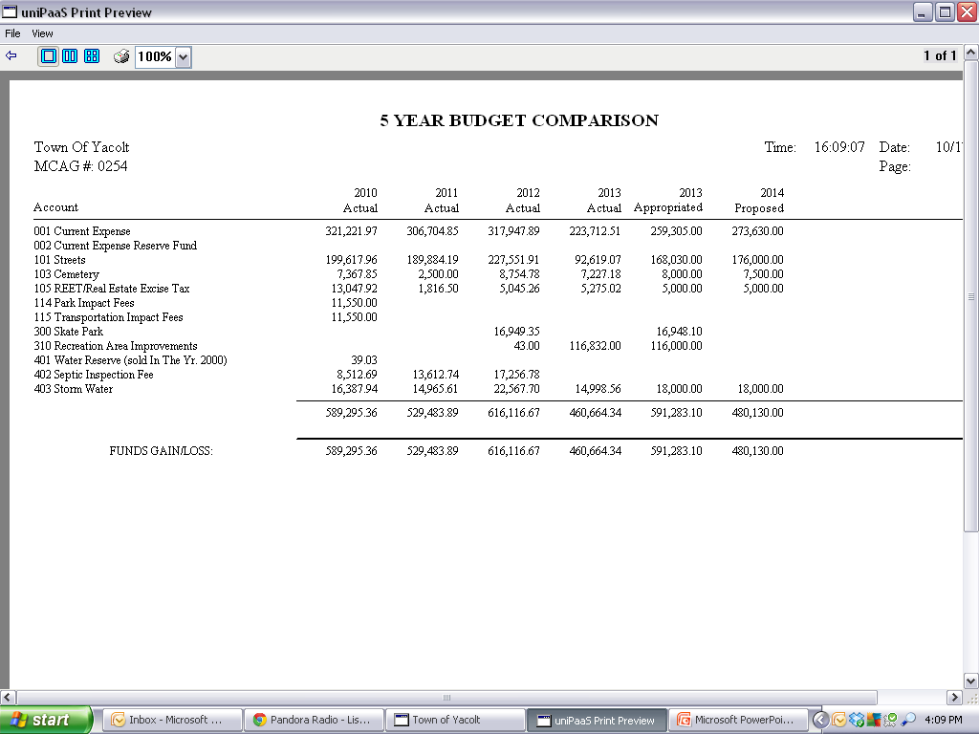
Notes:
As you can see the pattern of declining revenue, 2014 looks to be the start of recovery if we levy the full amount. We have been spending reserve the couple of years because revenue was less than expenses.

Slide 37
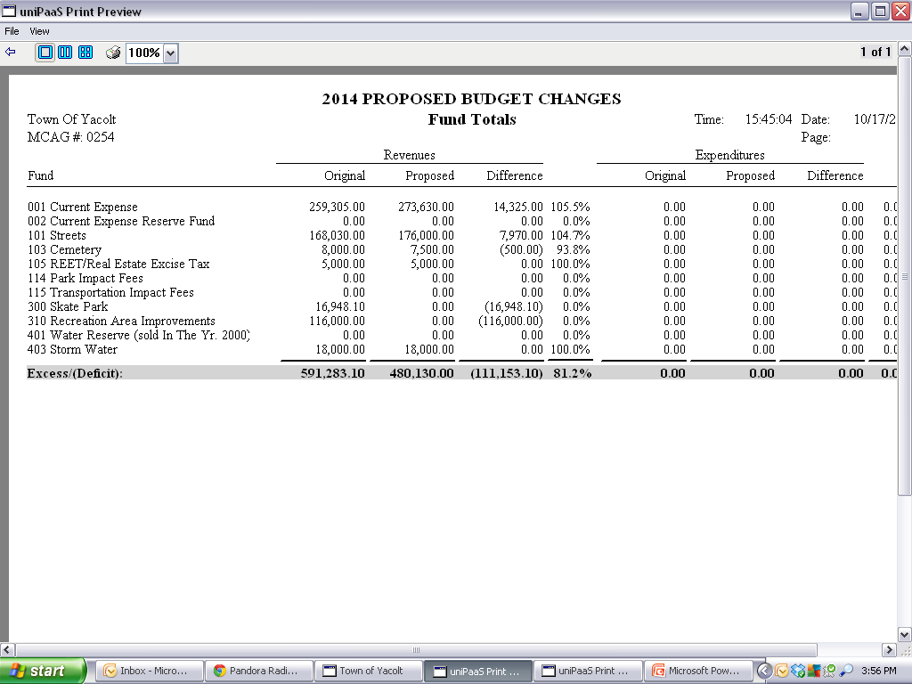
Budget Revenue Estimate 2014
** Excludes Beginning Balances**
** Includes all proposed revenue sources**

Slide 38

How do we Budget
We budget for outcome
We budget for goals
We budget for long term expectations
We budget for capitol improvements
“We budget for Success”

Slide 39
QUESTIONS?

