Slide 1
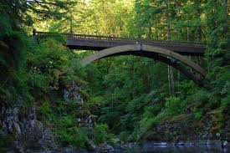
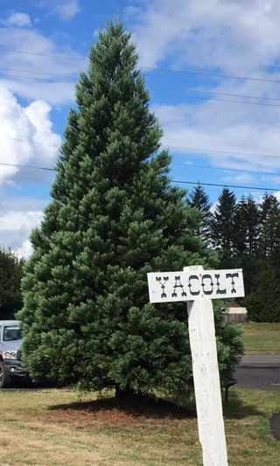
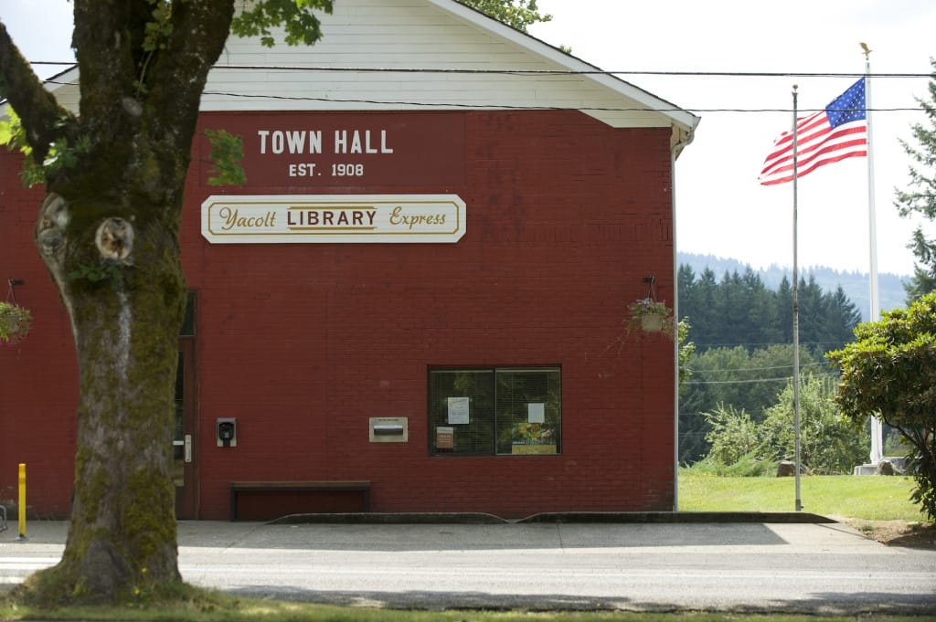
Town of Yacolt
2018
Revenue Resources
Proposed Revenue Budget

Slide 2
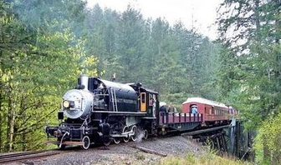
Fiscal Awareness
Smaller municipalities like us, need to focus on revenue as a priority, revenues are the core of our existence; expenditures are under direct control of department heads and can be managed more effectively. Decisions from elected officials are transmitted directly to the authorizing staff members.
Elected officials understanding of the processes help manage resources and the emphases on the importance of revenue.

Slide 3
Basis of Accounting
The State of Washington and the State’s Auditor’s Office set the accounting standards that we use here in Yacolt. As such, Yacolt records revenue and expenses on a cash-basis, similar to most small businesses, and is required to have an audit every two – three years depending on the type of audit. We prepare a budget every year and by law, we are not allowed to operate in a deficit.
The Town uses fund accounting which is a way to separate activities by type. In broad terms the Town has three major types of activities– governmental, proprietary and capital projects. Governmental activity, often called the Operating Budget, includes police, streets and park services and is what most people think of when they think of government (at least when they’re being kind). Property taxes are the main source of revenue funding the Operating Budget.

Slide 4
Basis of Accounting (cont’d)
Proprietary activity includes utility services – storm water, cemetery and it is funded through user fees. By law we cannot use your stormwater and utility fees to support general government and the operating budget.
Capital Projects are the last major type of activity. As the name implies these are construction projects which can be governmental or proprietary in nature depending on the project. These are usually funded by major grants.

Slide 5
Let’s Talk About Property Taxes and Some Basics

Slide 6
Basics of Property Taxes
A property tax is collected based upon the value of property
Property taxes typically apply to “real” property, such as land and buildings, and sometimes to “personal” property, such as equipment.
The concept of property taxes is very old, dating to at least 1692 in England.
Property Taxes are the most widespread form of taxation at the state and local level in the U.S.

Slide 7
Uses of Property Taxes in Washington
Property Taxes have existed since the Washington Territory was formed in 1853
The State has a property tax that is used for public school funding
Counties and cities use property taxes as a major revenue resource
Many special districts have property taxes as their only revenue source
The Legislature frequently creates new property tax authorities (e.g., Transit) because of a dearth of other options
Because so many governments have property taxes there are 3,191 “Levy Codes” (areas with unique combinations of property taxes) in the State as of September 2016

Slide 8
A Cautionary Note
Property taxes in many states, including Washington, are complex due to changes made over long periods of time
The Washington property tax system is thus very confusing
There are a few, if any, absolute truths: almost every rule has an exception
And there are exceptions to the exceptions……..

Slide 9
Basis of Property Tax:
Assessed Value
Assessed value or AV is the value of property for the purpose of taxation
In Washington, AV is usually intended to be the fair market value
Exceptions exist, such as agricultural and forest property being assessed at their current use, not fair market value (this required a Constitutional Amendment)
Other states define AV in different ways, making comparisons difficult.

Slide 10
Property Tax Rates
Rates are expressed as $ of tax per 1,000 of AV (e.g., a rate of $9.54 per $1,000 of AV)
.01 cents out of $1.00 is referred to as a “mill”, or thousandth part
Thus, property tax rates historically were referred to as “millage”

Slide 11
Uniformity
Many states, including Washington, require property taxes be imposed “uniformly”
This has 2 consequences:
Identical properties must have the same assessed value
Tax rates imposed by each jurisdiction must be the same throughout its boundaries.
In Washington, exceptions to uniformity require a Constitutional Amendment

Slide 12
Basic Property Tax Calculations
For a government:
Revenue = Tax Rate x AV within jurisdiction
For a property owner
Tax Bill = Combined Tax Rate x Property AV
Actual calculations are more complex (refund levies, etc.) but the basic principal is unchanged.

Slide 13
Property Tax Limitations:
3 Types
Property Tax limits vary widely by state but fall into 3 broad categories:
Limits on tax rates
Limits on annual revenue growth
Limits on the growth of assessed value or tax bills
Washington uses the first 2 types. The third type would violate uniformity.

Slide 14
Limits in Washington: Tax Rates
Some tax rates are unlimited, typically ones that are approved by voters
The maximum “regular” tax rate is 1% of “true and fair value” (Article 7, Section 2 of the Constitution) ~ note that this is not “assessed value” and does not apply to Port or PUD levies
Most (but not all) local taxes are limited to a sum of $5.90 per $1,000 AV
Each class jurisdiction has a maximum rate limit

Slide 15
Limits in Washington: Jurisdictional Rates
State: $3.60
Counties: $1.80
Cities: up to $3.60, depending on functions
County Road Districts: $2.25
Library Districts: $0.50
Fire Districts: up to $1.50
And there are many others!
There are sometimes options to shift among limits (e.g., county regular levy and road district levy)

Slide 16
When Rate Limits Are Exceeded
It is possible for the combined levies of government to exceed either the 1% of $5.90 limit – this often occurs where there are many overlapping governments
In that situation, “pro-rationing” occurs, in which certain governments lose their ability to levy some or all of their taxes.
The order of “pro-rationing” is different for the 1% and $5.90 limits

Slide 17
Interplay of Limits: Effects on Government
Revenue = Tax Rate x AV within jurisdiction
Assume AV grows by 5%
Revenue growth is limited to 1% plus assumed 1% for new construction
The result is that the tax rate must be decreased by about 2.9%

Slide 18
Interplay of Limits: Effect on Property Owner
Tax Bill = Combined Tax Rate x Property AV
Assume AV grows by 5%
Assume combined tax rate goes down by 2.9% (from prior example)
The result is that the tax bill goes up by 2%
Note that if the value of a particular property goes up faster than the average, the property tax bill can grow significantly despite the limits.

Slide 19
Exceptions to Limits
(You knew there had to be some)
Excess levies for capital (debt service on bonds) requires 60% “yes” vote and turnout requirement
One year excess levies for any purpose: requires 60% “yes” vote and turnout requirement
Local school levies: requires a 50% “yes” vote
Levy lid lifts: raise the 1% revenue growth limit but the jurisdiction’s rate limit; requires a 50% “yes” vote

Slide 20
New State Property Tax for Education
The State’s response to the Mc Cleary case (inadequate K-12 funding) included a new statewide property tax to replace most of the local levies
The effect is to shift taxes from areas with low AV (such as rural areas) to areas with high AV (Seattle, Bellevue, San Juan Islands, etc.)
School-related property taxes will go up everywhere in 2018 due to the overlap of the new state and existing local levies
After that, taxes go down in some areas and up in others.

Slide 21

Property Taxes & Yacolt
Home values are rising.
There are more single family homes being built
New Construction from 2017
New Commercial Building proposed “ Old Mercantile”
Banked property tax capacities are reached and no longer available to assist in the growth recovery of the recession and in most if not all of the surrounding districts that effect Yacolt.
The formula for calculating the [total levy dollar amount] for districts is changing and they are hitting their rate limits. Additionally, there are still limits on the growth of the [total levy dollar amounts].

Slide 22
Property Tax Revenue
Property taxes are the single most valuable resource for the town.
With out property tax revenue Yacolt would cease to exist as a Town.
This revenue type is the only source that is guaranteed to be a steady source of funding.
1/3 of the property tax dollars that are allocated to the town are placed in the General Fund or General Operating Fund.
2/3 of the property tax dollars that are allocated to the town are placed in the Street Fund.
Each year municipalities, fire districts, are allowed to increase property tax levy by 1% without a vote of the people.

Slide 23
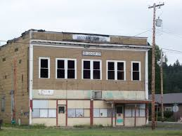
Does The Town Keep All Collected Tax Dollars?
NO
The town only gets to keep a portion of the total tax dollars that are collected.
The funds collected are distributed to various districts in the county as explained in the previous slides.

Slide 24
Includes regional districts such as libraries, parks and recreation, emergency medical and hospitals. Not necessarily located in the Town.
Does not reflect the additional levy passed by local fire district in 2017

Slide 25


Stretching the Dollars ~ Doing
More with Less
And yet that 14% sliver provides us with the largest portion of our total operating revenues.
That means we provide the bulk of our services i.e., public safety, goods and services, parks and streets, repairs and maintenance with a relatively small amount of your money. Here’s a chart showing how your property tax dollar is used.

Slide 26
How Do We Apply Tax Dollars?
This does include State Share Revenue which makes up the difference in fund totals. However, these revenues vary from year to year depending on legislation. Unfortunately these are often never restored once they have been reduced by legislation.

Slide 27

Tax Dollars Collected ~ Yacolt doing a lot with a little
In 2017 the amount that should be collected from property tax to support services was certified by the County Assessor at a value of $193,523.76 That equates to $2.025123293 per $1,000 in assessed value.
1/3 of which going to the general fund and 2/3 going to the street fund.
Keeping in mind that this is dependent on everyone pays their property taxes.

Slide 28
Recap
Most levies in Clark County are subject to several limits, some are on the growth of the levy, while others are on how the levy is calculated.
Property Taxes are complicated with exceptions to rules and rate limits
Revenues are limited to assessed values, new construction and annexations.
Yacolt is limited to the Constitutional limit of 1%

Slide 29

State Shared Revenue Resources

Slide 30

What Are State Share Revenues?
These are tax dollars collected that are shared among the county, cities and towns based on per capita and % that are determined by the State Legislative Authority.
Examples of Share Revenue are:
Motor Vehicle Tax
Liquor Tax
Liquor Excise Tax
City Assistance
Liquor Profits
Criminal Justice
Marijuana Taxes
However these revenues are governed by the State in how they are allocated to funds and how they are allowed to be spent.

Slide 31

Liquor Taxes
In the past, cities/towns collected these funds which assisted in the ability to balance budgets, but with the passage of Initiative 1183 in 2011 that all changed. In 2012 a permanent diversion of 10 million dollars of city money went to the state general fund. 2013-2015 reduced the share from 35% to 22.5% remaining until 2017-2018
2017-2019 State budget, passed by legislators contains a provision to return the share back to the 35% in 2017-2019. (state budgets have a lag)
Projections of 21.798.888 will be distributed in 2018 on per- capita bases to cities/ towns and 4.871.584 going to counties

Slide 32

Currently legislation remains in conflict. There continues to be dialog on these subjects.
AWC ( Association of WA. Cities) is lobbying hard on behalf of all the cities and counties in the State. They are working toward a resolution to resolve the differences and “put back revenue”.
We continue to monitor the progress of these decisions
These funds are distributed to both the General Operating Fund and Streets and make up the difference in fund revenue.

Slide 33
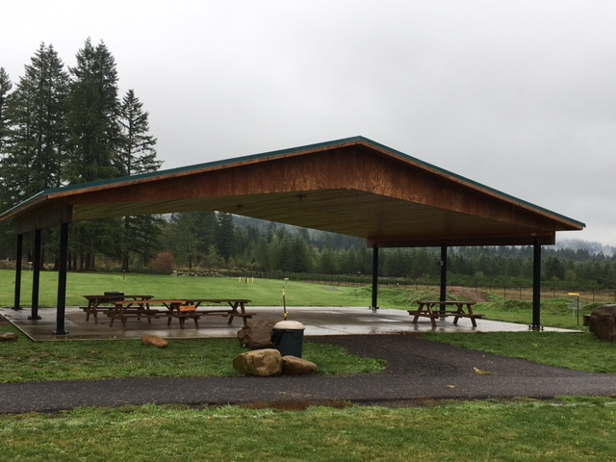
What Other Revenue Resources Are Available?
Additional components of revenue sources are even less of a guarantee:
          Charges for Services
          Licenses and Permits
          Fines and Forfeitures
Charges for Services funds come from things like faxes, notary, rentals, copies etc.

Slide 34

Licenses and Permits funds come from business licenses and building permits. While there is construction along with a few small housing developments, this is still a limited resource of funding.
Business Licenses have been somewhat consistent revenue over the last couple of years. The challenge is keeping business’ here and doing business. The other side is catching those who are doing business in the Town without a license/permit.

Slide 35

Fines and Forfeitures funds come from the Criminal Justice funds that are allocated to the Town. These come from criminals who are fined and must pay restitution. Again, based on per capita. We only receive 68% of total fine/restitution and the remaining 32% goes to the state. In addition 1.75% of the local portion must be remitted to the county for crime victims and witness programs. (NOTE: all money received from DUIs are remitted to the state, not locally).
A portion of the money collected from pet licenses partially offsets the costs of animal control services

Slide 36

Storm Water Fees
Yacolt residents pay storm water fees that are realized on their monthly Clark Public Utility Bills. While this is a source of revenue it has restrictions as indicated above in Basic Accounting. This is a separate fund that has limitations on expenses that can be charged to it. Examples: drainage, soil and water conservation, engineering plans and studies, repairs and maintenance. These are NOT funds that can be used in General Operations.

Slide 37
Sales Taxes
These are taxes that are collected from retail sales, internet based sales and other types of business that charge sales tax. Yacolt currently does not have a sales tax on internet based sales. Revenue from these sources are dependant on sales. Yacolt having few businesses needs to look at all available options for taxation that it is missing due to outdated codes.
Additionally, there are taxes collected from telephone use and other utilities. There is no competition for the utilities to increase the tax base.
All of these types of taxes are allocated to General Operations to fill in where there is no property tax allocation.( Remember only 33% of property tax dollars go to the General Fund) They are based off of per capita/% calculations through the State Treasurer.

Slide 38

Do You Know How Retail State Sales Taxes Are Distributed?
21

Slide 39

REET/ Real Estate Excise Tax
These are tax revenues that are distributed from the State Treasurer. These are treated much like Storm Water. They have restrictions on how they are spent. They are not for general operations or for administration costs. However, 1% can be used for administrative costs in the Street Fund currently. These funds are marked for Capital Improvements.

Slide 40
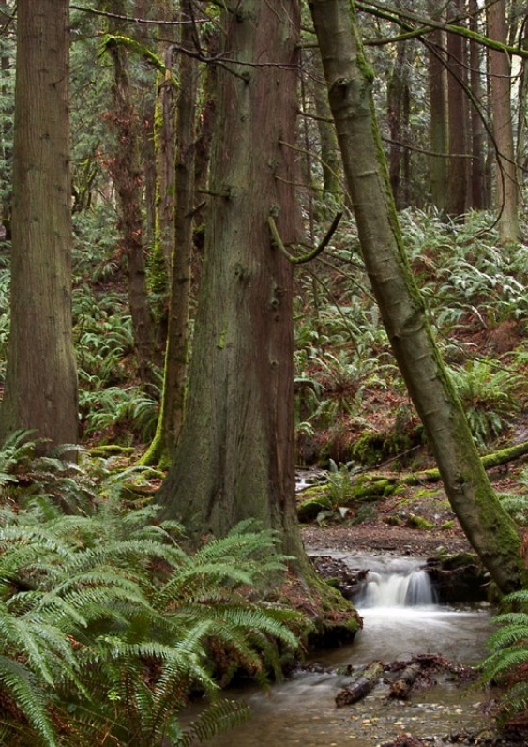
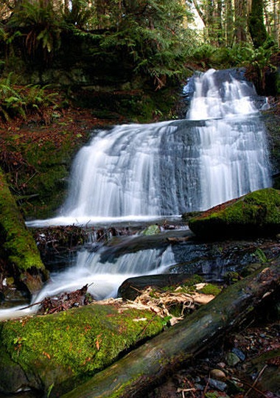
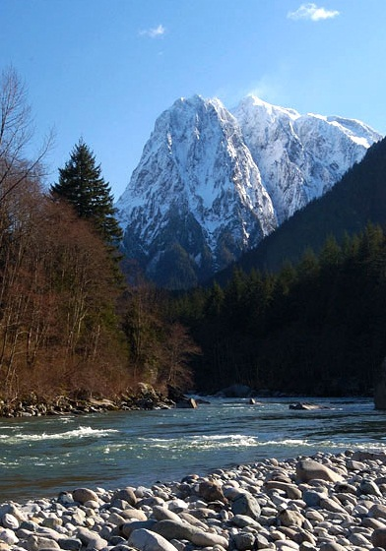
Use Fees
We are currently charging for rental of town hall and parks facilities at the rate of 10.00 per hour for reservations and refundable garbage fees. The maintenance and repairs to the parks and facilities far exceeds the minimal amount of revenue collected to support these services.
23

Slide 41

What about the Marijuana Tax?
Municipalities that have approved sales and grow operations are seeing the benefits of this tax in infrastructure and law enforcement
24
Notes:
Picture with background removed
(Intermediate)
To reproduce the picture effects on this slide, do the following:
On the Home tab, in the Slides group, click Layout, and then click Blank.
On the Insert tab, in the Images group, click Picture.
In the Insert Picture dialog box, select a picture and then click Insert.
Select the picture. Under Picture Tools, on the Format tab, in the Size group, click the Size and Position dialog box launcher. In the Format Picture dialog box, resize or crop the image so that the height is set to 7.5” and the width is set to 10”. To crop the picture, click Crop in the left pane, and in the right pane, under Crop position, enter values into the Height, Width, Left, and Top boxes. To resize the picture, click Size in the left pane, and in the right pane, under Size and rotate, enter values into the Height and Width boxes.
Also under Picture Tools, on the Format tab, in the Adjust group, click Color, and then under Recolor click Grayscale.
Also in the Adjust group, click Corrections, and then under Brightness and Contrast, click Brightness: -40% Contrast: +20%.
On the Home tab, in the Clipboard group, click the arrow to the right of Copy, and then click Duplicate.
Select the second picture. On the Home tab, in the Drawing group, click Arrange, point to Align, and then do the following:
Click Align to Slide.
Click Align Middle.
Click Align Center.
Under Picture Tools, on the Format tab, in the Adjust group, click Reset Picture.
Also under Picture Tools, on the Format tab, in the Size group, click the Size and Position dialog box launcher.. In the Format Picture dialog box, resize or crop the image to focus on the main subject in the picture. (Example picture is set to 3.54” height and 3.24” width). To crop the picture, click Crop in the left pane, and in the right pane, under Crop position, enter values into the Height, Width, Left, and Top boxes. To resize the picture, click Size in the left pane, and in the right pane, under Size and rotate, enter values into the Height and Width boxes.
Also under Picture Tools, on the Format tab, in the Adjust group, click Remove Background, and then do the following:
To remove additional background areas from the picture, on the Background Removal tab, in the Refine group, click Mark Areas to Remove. Select all of the additional areas to be removed.
To keep additional areas of the picture that have been removed, on the Background Removal tab, in the Refine group, click Mark Areas to Keep. Select all of the additional areas to be kept.
Click Keep Changes in the Close group when finished.
To reproduce the shape effects on this slide, do the following:
On the Home tab, in the Drawing group, select Rectangle.
On the slide, drag to draw a rectangle.
Select the rectangle. Also on the Home tab, in the Drawing group, click the Format Shape dialog box launcher.
In the Format Shape dialog box, in the Size tab, enter 7.5” into the Height box and enter 4” into the Width box.
Also in the Format Shape dialog box, in the Fill tab, select Gradient fill, and then do the following:
In the Type list, select Linear.
In the Angle box, enter 90°.
Under Gradient stops, click Add gradient stops or Remove gradient stops until three stops appear in the slider.
Also under Gradient stops, customize the gradient stops as follows:
Select the first stop from the left in the slider, and then do the following:
In the Position box, enter 0%.
Click the button next to Color, and then under Theme Colors click Black, Text 1 (first row, second option from the left).
In the Transparency box, enter 100%.
Select the second stop from the left in the slider, and then do the following:
In the Position box, enter 40%.
Click the button next to Color, click More Colors, and then in the Colors dialog box, on the Custom tab, enter values for Red: 47, Green: 91, and Blue: 77.
In the Transparency box, enter 0%.
Select the third stop from the left in the slider, and then do the following:
In the Position box, enter 100%.
Click the button next to Color, and then under Theme Colors click Black, Text 1 (first row, second option from the left).
In the Transparency box, enter 90%.
Also in the Format Shape dialog box, in the Line Color tab, select No Line.
Select the second picture. On the Home tab, in the Drawing group, click Arrange, and then click Bring to Front.
To reproduce the text effects on this slide, do the following:
On the Insert tab, in the Text group, click Text Box, and then on the slide drag to draw your text box.
Enter text in the text box, and then select the text. On the Home tab, in the Font group, do the following:
In the Font list, click Calisto MT.
In the Font Size list, click 36 pt.
Click Font Color, and then under Theme Colors click White, Background 1 (first row, first option from the left).
Position text over the least transparent part of the gradient.

Slide 42
Revenues We Do Not Receive Like Other Municipalities:
Lodging (Hotel-Motel) Tax
Cities may tax the amount charged by hotels, motels, rooming houses, private campgrounds, RV parks, and similar facilities for periods of occupancy of less than one month. The tax is collected as a sales and use tax by business and is paid by the customer at the time of transaction.
These can also be used toward tourism.
Since the town does not have any of the above we do not collect for this.

Slide 43

Gambling Excise Tax
Cities are authorized to collect taxes on gambling activities within specified limits. The state does not impose gambling excise taxes. The state makes a distinction in what gambling activities can be taxed and in tax rates based on whether the gambling activities are conducted by charitable and non profit organizations or whether they are conducted for profit. There are maximum rates depending on the activity.
Since we do not have a casino or card room this is also a tax that we do not collect, additionally we have a code that prohibits some of these activities.

Slide 44
Local Option Commercial Parking Tax
This tax may be levied by a city within its boundaries and by a county in the unincorporated areas. There is no limit on this tax rate and many ways of assessing the tax are allowed. Rates vary by any reasonable factor, including location of the facility, time of entry and exit, duration of parking, and type or use of vehicle. The parking business owner collects this tax and remits to the county for remittance. There are currently no counties that levy this tax, but there are 6 cities in the State of Wa. that do.

Slide 45
Transportation Benefit Sales Tax
Cities may form a transportation benefit district under RCW 36.73 to acquire, construct, improve, provide, and fund transportation improvements. One funding option is a voter approved 0.2 percent sales tax. The sales tax may be levied for an initial 10 years and renewed for another 10 years with a vote.
Additionally a Transit Sales and Use Tax may be levied up to 0.9 percent for public transportation uses.
We have discussed in the past the creation of transportation benefit district charging a flat fee for vehicle licenses in order to fund transportation improvements. With changes in legislation more cities are utilizing this benefit of revenue by creating these boards.

Slide 46
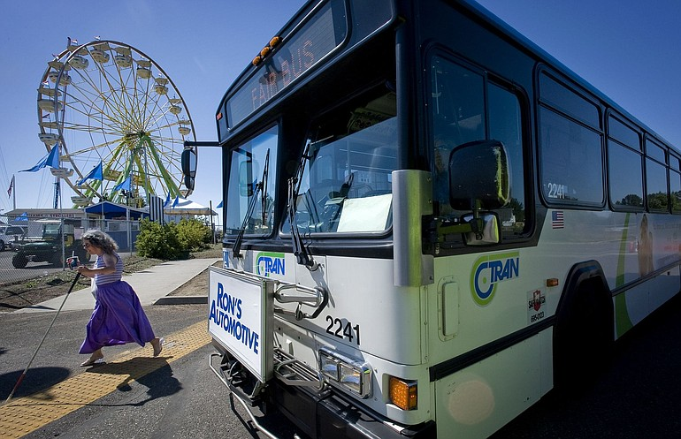
High Capacity Transportation
Any county or city with a transit system, metropolitan municipal corporation, public transportation benefit area, high capacity transportation corridor area or regional transit authority may ask the voters to levy up to 1.0 percent sale and use tax specifically for high capacity transportation systems. The tax must be voter approved by majority of the vote. Currently, larger cities such as King, Snohomish, and Pierce Counties have this tax levy.

Slide 47
2018 Shared Expected Revenue
 |  |  |  | Per Capita
Liquor Profits |  | $13,985.00 |  | $8.45
Liquor Tax |  | $7,729.00 |  | $4.67
Criminal Justice |  | $1,000.00 |  | $0.31
Criminal Justice Special |  | $1,721.00 |  | $1.04
Gas Tax |  | $34,490.00 |  | $20.84
Increased Gas Tax |  | $1,523.00 |  | $0.92
Mutli Modal Distribution |  | $1,738.00 |  | $1.05
Marijuana Excise Tax |  | $960.00 |  | $0.58
Total |  | $63,146.00 |  | $37.86

Slide 48
How Government Is Not Like A Business
It’s popular these days to ask why government can’t be more like a business. Cut the “Fat” Although there are some parts of government that act like a business, the construct of government is the opposite of business in some important ways. Let’s start with a central proposition:
Government is often criticized for it’s for “tax and spend” policies; however that is the foundation of government. The revenue has to come first, nothing can happen without it.
In business, as the saying goes, “You have to spend money to make money.” So for business it’s opposite of the government. In business, you incur expenses first in the hope of making money later.
The table following highlights some of the ways in which government and business are different.

Slide 49
Government vs. Business
 | Government | Business
Business Cycle | Tax and then spend. | Spend and then earn revenue.
Intent | Provide service by maximizing spending on clients. | Earn profits by minimizing spending on goods and services sold to clients.
Payroll | Limited to resources avail. | Minimize worker’s pay.
Budgeting | Maximize services up to revenue available. | Minimize costs under revenue available.
Communication | Principals make decisions in public. | Principals make decisions in private.
Mobility | Governments can’t relocate. | Businesses can relocate.
We present these differences not to create a fight, as both are legitimate models, but to encourage you to see that we have a different perspective from the business world. One common trait government and business share is the need for efficiency. And we strive for that here in Yacolt especially in the tough economic times that we all face.

Slide 50
Challenges for Yacolt:
2018 Yacolt applications for Community Block Grants and other grant funds which may require match funding amount in dollars and/or in-kind ~ competitive applications & no guarantee of grant awards
2018 Legislative Session impacts from Mc Cleary decision and budgetary impacts
The Operational Costs for 2 Parks ~ Streets ~ Sidewalks, Stormwater ~ Town Owned Buildings ~ Easements, Town Hall~ Town Vehicles and Equipment equals costly repairs to ageing vehicles and replacement costs for irreparable equipment. Building Maintenance, Software Maintenance & Improvements to provide better operations and transparency. Plan updates per government guidelines( e.g., Facilities Maintenance, Sewer Plan, Growth Management)
Continuing the current level of services with increased costs
Inflation rate ~ Can only increase property tax 1%.
State Share Funding decreases without intervention from Legislators.
Limited amount of Sales Tax Revenue ~ Limitations of local businesses
No Planning for the future of Businesses to locate in Yacolt
Employer Contributions State/ Federal ~ Legal Council Costs ~ Minimum Wage Requirements, Federal/State Paid FMLA & Sick Leave Requirements
Making Yacolt a destination City

Slide 51

Council is tasked with planning for the long term and replacing funds expended for infrastructure since funds were diverted to account for expense.
Mayor is tasked with maintaining core mission, priorities and operations.
Flat revenue streams of the past have had an affect on our budget. However, the budget is a small piece of long term planning.

Slide 52

What Changes Have Been Made in 2017?
Local businesses are working together.
Building Department implementation has seen minor rewards in revenues
Business License compliance has been mainstreamed.
Compliance from citizens on building permits has improved
Municipal Code Published.
Working on mainstreaming process for easier access to citizens

Slide 53

Ideas to Increase Revenues
Create a transportation benefit district
Tourism~ Yacolt as destination
Support local business
Planning services to promote business location in Yacolt
Your Ideas Are
Welcome!!

Slide 54
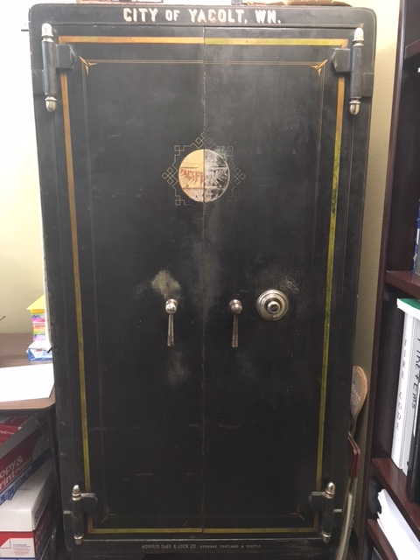
Estimated Levy Increase
Actual assessed values due at the end of October. We can only estimate on the limit we currently have.
Actual Levy for 2015 = $189,373.36 x constitutional limit of 1% increase = 1,893.73 (101%) = $191,269.09
estimated levy collection of $191,269.09 for 2017
** this will likely be higher due to increased housing in 2016 **

Slide 55

But Wait!
We don’t know yet what the YACOLT actual assessed valuations are ……………
This is purely a guess ~
an estimate ~
and desired outcome~

Slide 56

2018 Estimated Revenue Budget

Slide 57
Budget Revenue Estimate 2018
Excludes Beginning and End Balance

Slide 58
Budget Comparison Fund Totals
Note: conservatively estimated ~ construction driven

Slide 59
How Do We Budget?
We budget for outcomes
We budget for goals
We budget for long term expectations
We budget for capital improvements
“We Budget for Success”

Slide 60


